Slide 1
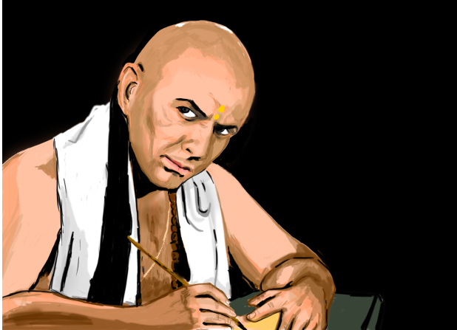
Learning – Chanakya’s Style
Authored and
Presented by:-
Arpit Gaur
Pradeep Borse
Tukaram Dhage
Rameshwar Gupta

Slide 2

Start , But First Ask
Before you start work, ask
Why am I doing it?
What the results might be?
Will I be successful?
If the answer is satisfactory,
go ahead.

Slide 3


Be Determined
If you are determined,
nothing is impossible.
“Never settle for anything less
then what you deserve.
It is not ego, it is self-respect”.

Slide 4
Think Positive
Think
Belief
Action
Habits
Result

Slide 5
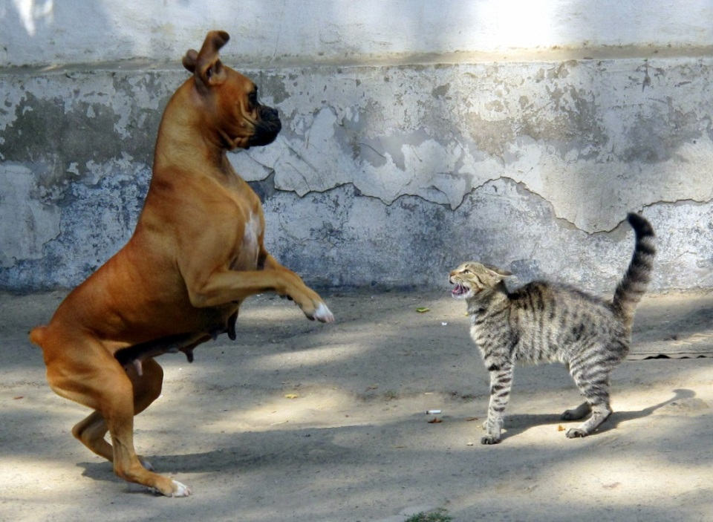
Overcome Fear
“As soon as the fear approaches near,
attack and destroy it.”
Face
Everything
And
Rejoice

Slide 6

Do Great To Be Great
“A man is great by deeds not by birth.”

Slide 7

Identify Gems
“There are three gems upon this earth- food, water, pleasing words.
Fools (mudhas) consider pieces of rocks
as gems.”

Slide 8

Give-up Shyness
“He who gives up shyness
- in monetary dealings,
- in acquiring knowledge,
- in eating and
- in business,
becomes happy”.

Slide 9
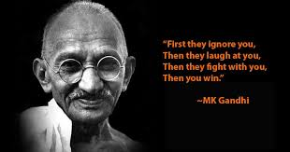
World’s Biggest Power
“The world’s biggest power is the youth and
the beauty of a woman”
Education beats beauty and youth
Powerful mind → Unconquerable.

Slide 10
Never Share Secrets
Various types of secrets:-
Financial trouble
Personal issues
About wife
When you are insulted
“Never share your secrets with anybody,
it will destroy you”.

Slide 11

Once Started, Just Do It !
“Once you start working on something,
don't be afraid of failure and
don't abandon it.
People who work sincerely are the happiest”.

Slide 12






Motivation and Impulse

Slide 13
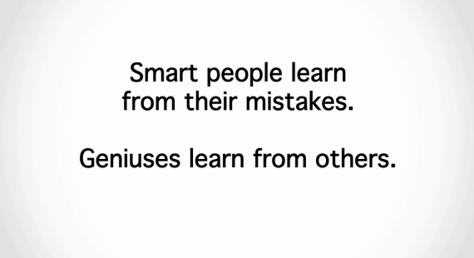

Learn From Others
“Learn from the mistakes of others...
you can't live long enough
to make them all yourselves!!”

Slide 14
Ways To Double Salary
Deep desire rather than mere hope
Choose your functional area carefully or
change it (if possible)
Skill Up
If nothing else works,
take charge of career and move.

Slide 15

Fate == God’s Grace
“Without god’s grace,
even an easy task becomes
difficult to accomplish.”
Get
Out of
Doubt

Slide 16

Any Questions ??

Slide 17
Thank you!

